Slide 1
Query Store without SQL 2016 = Open Query Store
William Durkin

Slide 2



William Durkin
Data Platform Architect @ Data Masterminds
10+ Years with SQL Server
DBA / System Architect
Data Platform MVP (March 2017)
williamdurkin.com
@sql_williamd
williamdurkin@datamasterminds.io

Slide 3
Agenda
What is Query Store?
How does it work?
What is Open Query Store?
How does it work?
Look under the covers
What is the future?

Slide 4
Query Store Feature Recap
Query Store is the “flight recorder” of query performance
Enabled on a per-database level
Execution Plans and query runtime statistics are captured and persisted on-disk per-database
Available in all editions of SQL Server 2016

Slide 5
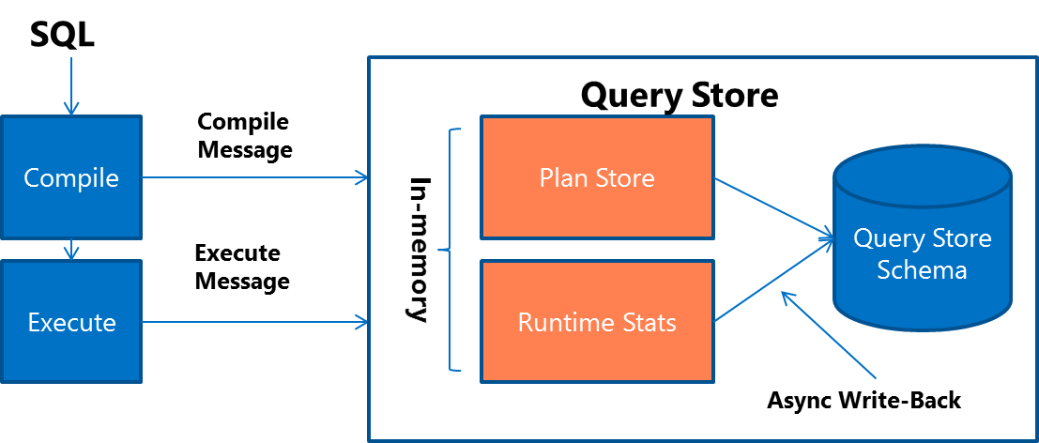
Query Store Feature Recap
Source: https://msdn.microsoft.com/en-us/library/mt631173.aspx

Slide 6
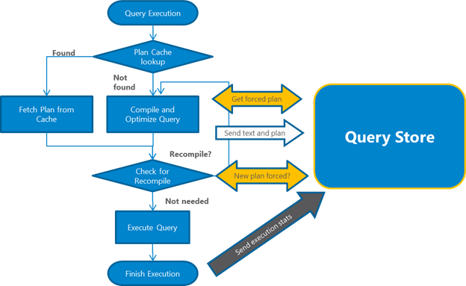
Query Store Feature Recap
Source: https://msdn.microsoft.com/en-us/library/mt631173.aspx

Slide 7
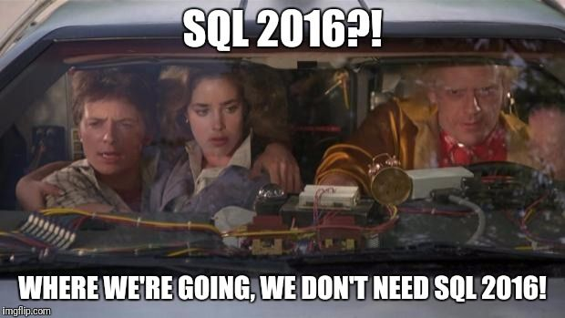

Slide 8

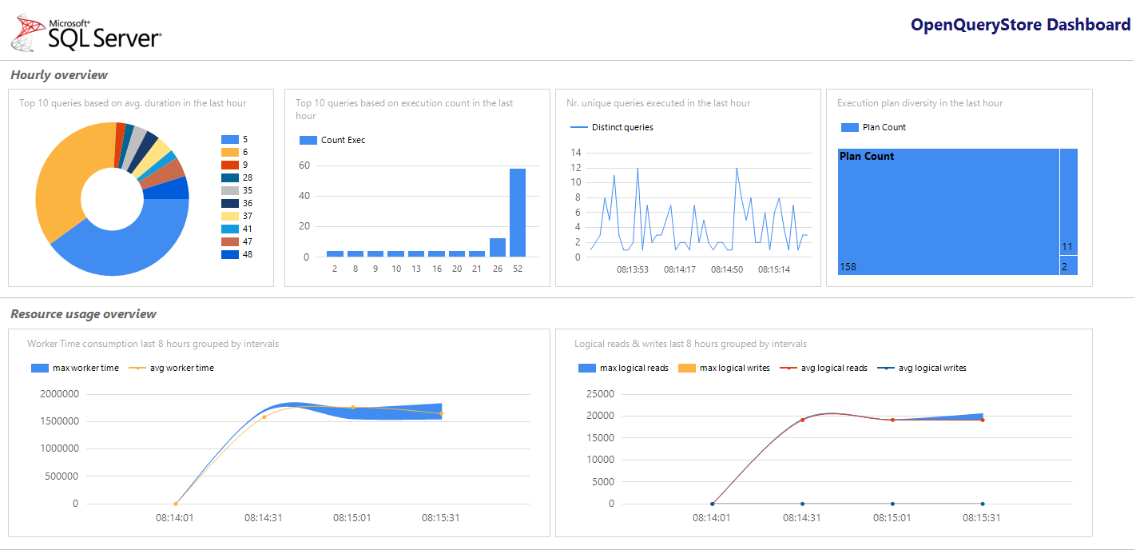
What is Open Query Store?
Query Store like functionality in < SQL Server 2016 (2008-2014)
Two collection methods: -> classic -> centralized
Native data collection
Reporting from inside SSMS
Free and open-source!

Slide 9
What is Open Query Store NOT?
Not a replacement for Query Store!
Not fully integrated into SSMS
Not a replacement for a traditional monitoring tool
Not perfect!
Notes:
Cannot replace it. QS is in the engine. Collects actual executions
OQS is a manual install, no context menu support (yet?)
Monitoring tools do alterting/baselining. We are just collecting data here
We make mistakes. We have limits because we are not MS

Slide 10
Open Query Store Internals
Open Query Store
Open Query Store Schema
Source: William and Enrico’s beer-fueled brains

Slide 11


Slide 12
Future of Open Query Store
Better performance
Ability to force plans like in QS
SQL 2005 Support
What do you want? ☺

Slide 13
Resources
http://openquerystore.com
https://github.com/OpenQueryStore/OpenQueryStore
@openquerystore on Twitter

